Slide 1


Anthony Pritchard
Storm Geomatics
www.getkidsintosurvey.com

Slide 2
LAND SURVEYING
or
GEOMATICS
www.getkidsintosurvey.com

Slide 3



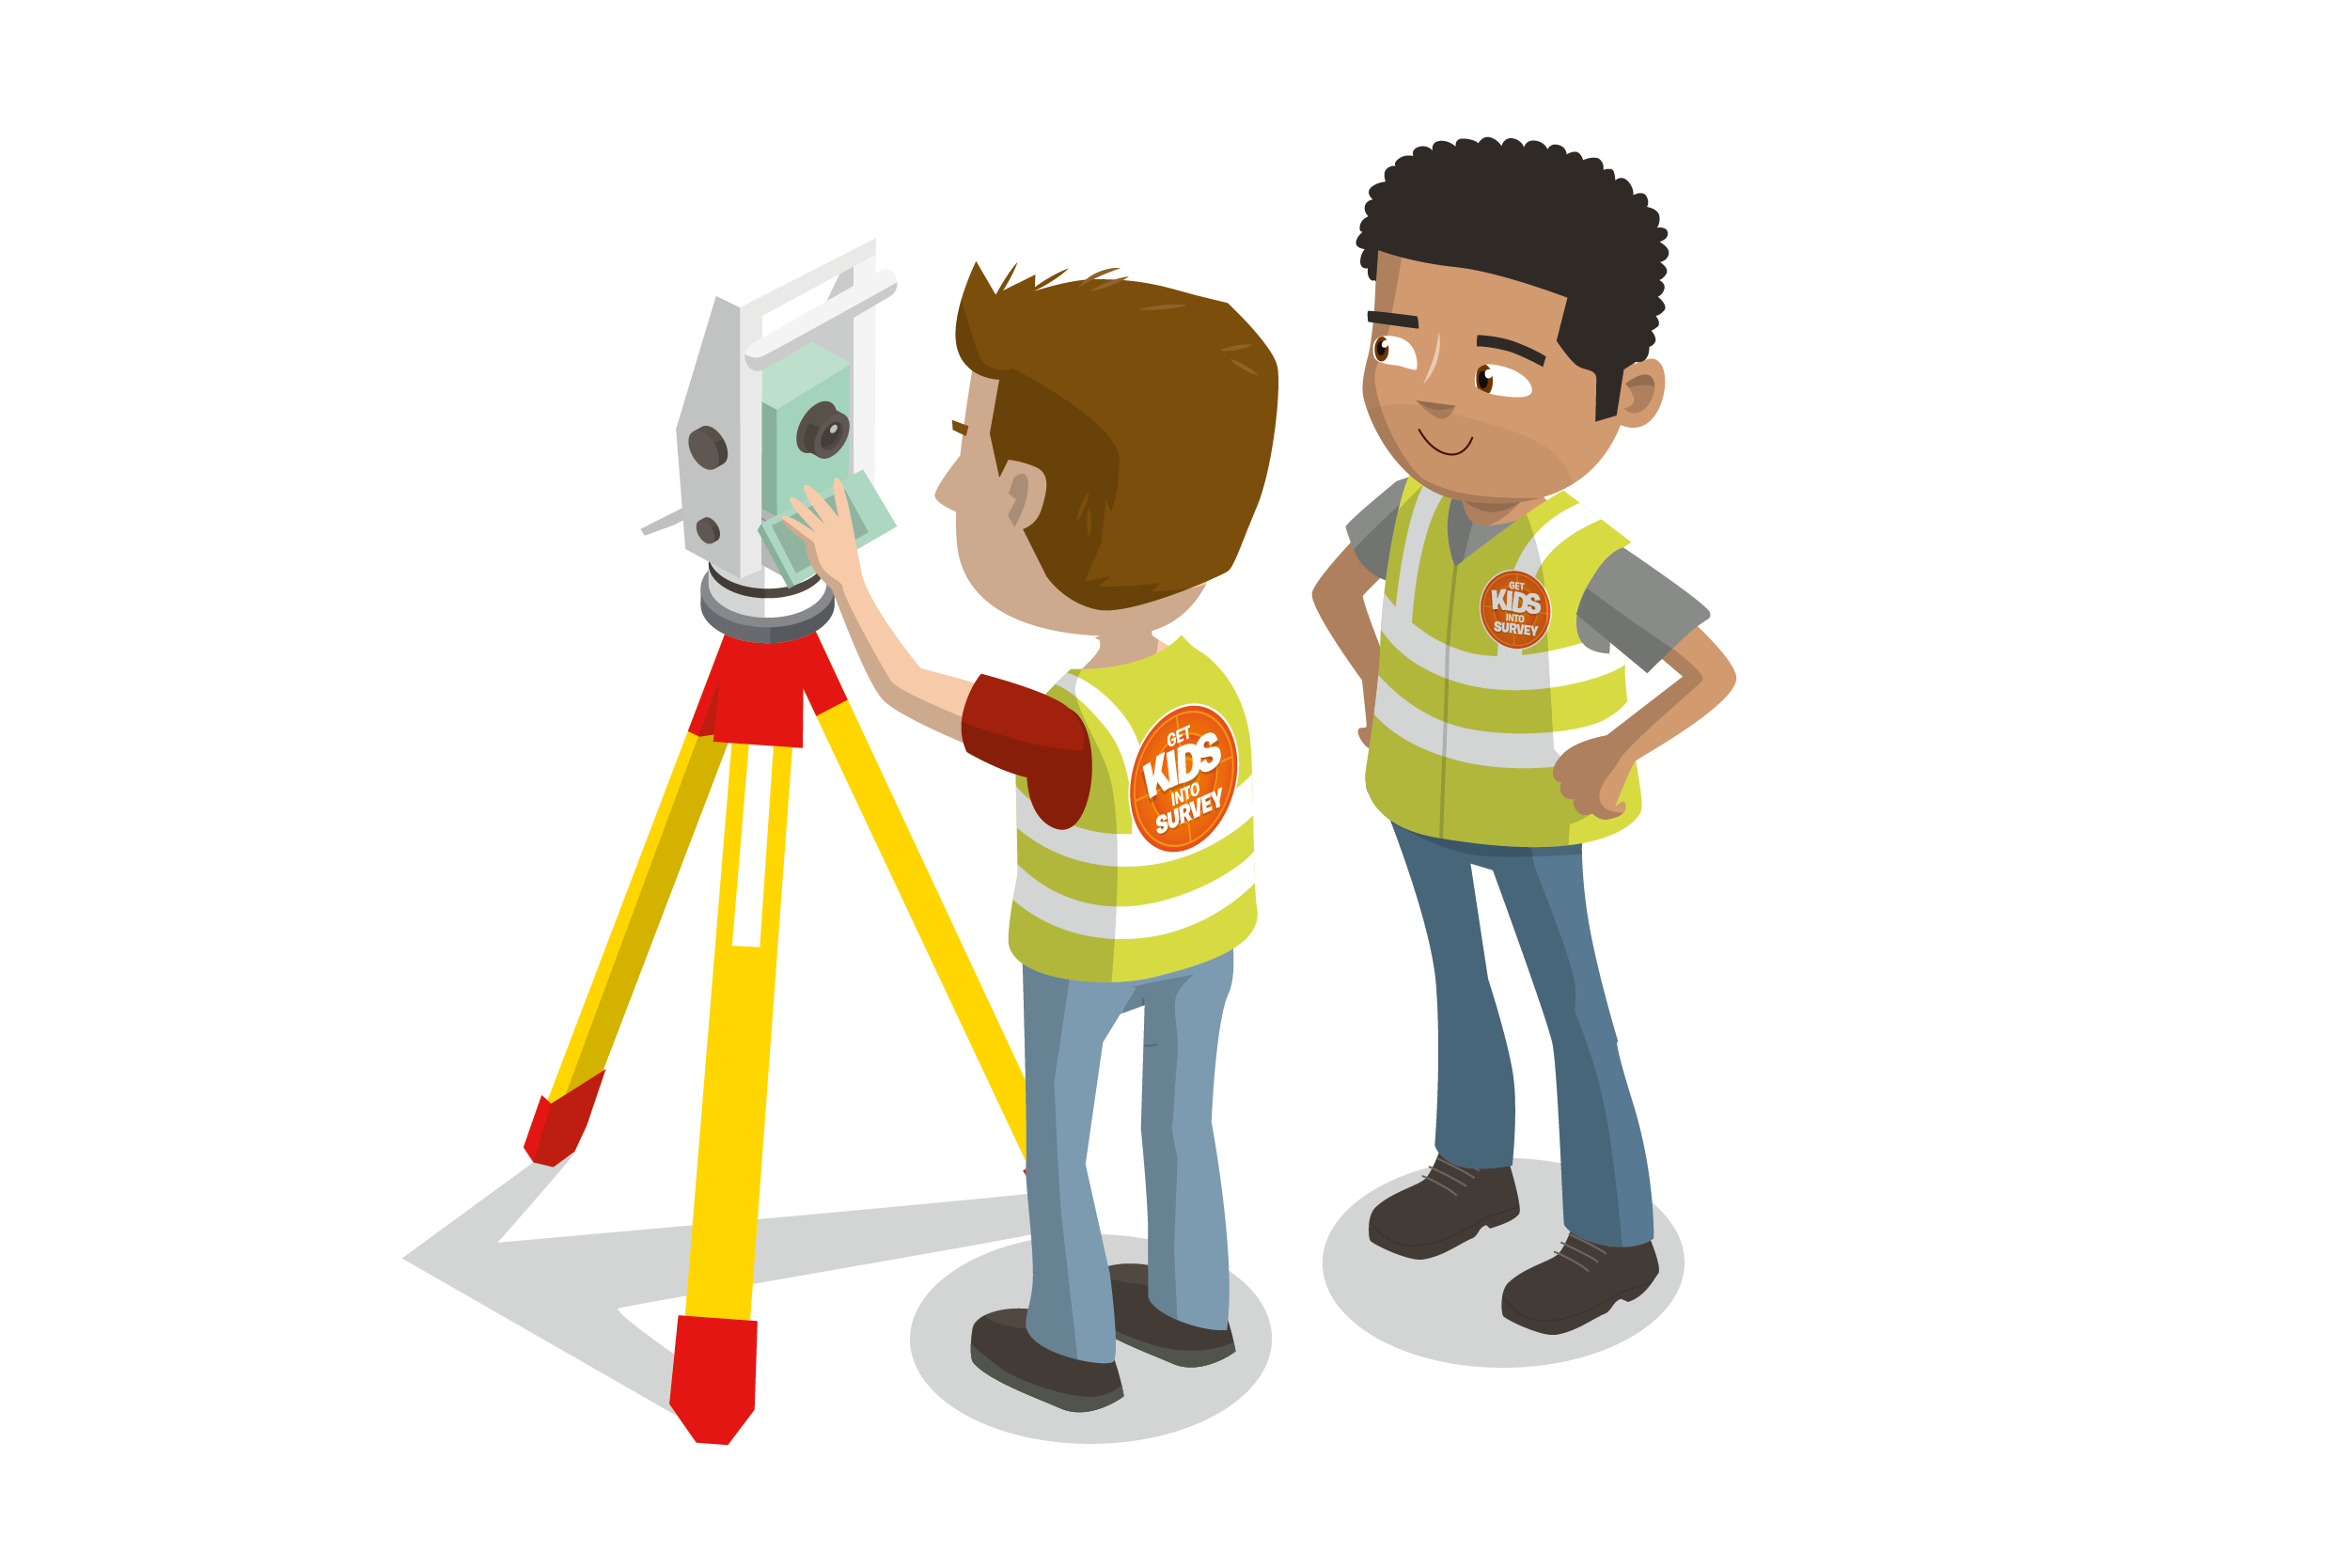



So…. what is land surveying and what do land surveyors do?
www.getkidsintosurvey.com

Slide 4
Make maps
Measure things
Make sure things are built in the correct place
Monitor movement, building or flood defence
Machine control
Calculate quantities of materials
Cut and Fill analysis
Athletics
World records
Chartered Institute of Civil Engineering Surveyors
www.getkidsintosurvey.com

Slide 5
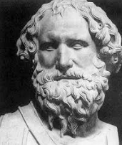

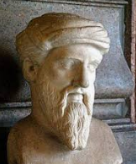


History
Where did it all start?
www.getkidsintosurvey.com

Slide 6
GNSS
GPS
Global Navigation Satellite Systems
GPS/Navstar – American
GLONASS – Russian
Galileo – European
BeiDou – Chinese
Quasi Zenith – Japan
NAVIC - India
www.getkidsintosurvey.com

Slide 7
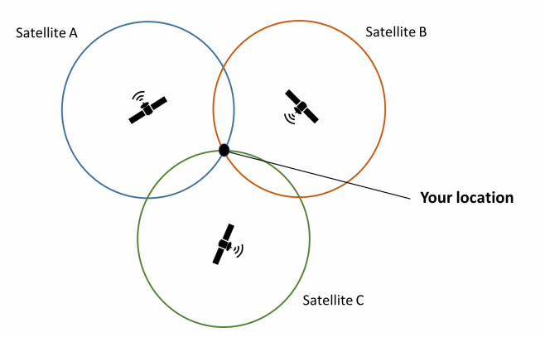

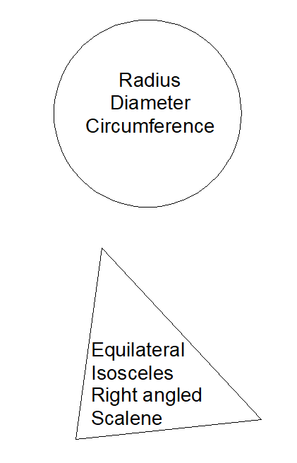
STEAM
Science, Technology, Engineering, Arts, Maths
Pythagoras theorem
Geometry
Trilateration
www.getkidsintosurvey.com

Slide 8
So…what do I get to do as a surveyor?
https://www.youtube.com/watch?v=OqSsDA5Pod8
https://www.youtube.com/watch?v=FZccEXuWXzM
https://www.youtube.com/watch?v=l2UpMEPX1_M
https://www.youtube.com/watch?v=0fTdi7edV_o
https://www.youtube.com/watch?v=MYuFHHb6FA4
https://www.youtube.com/watch?v=Zs28va5080w
www.getkidsintosurvey.com

Slide 9
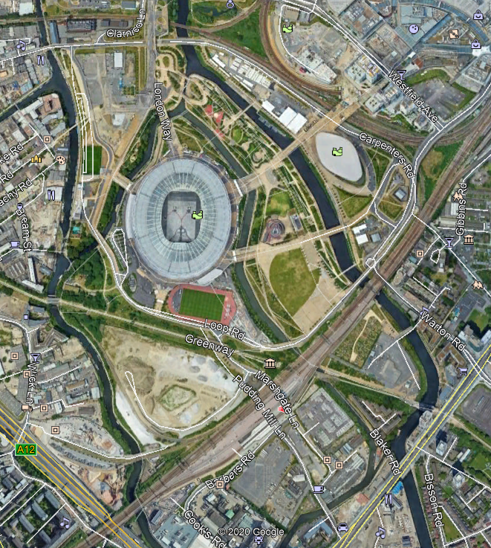

Jobs in Surveying
www.getkidsintosurvey.com

Slide 10
what3words
https://what3words.com/ahead.mysteries.flagpole
www.getkidsintosurvey.com

Slide 11


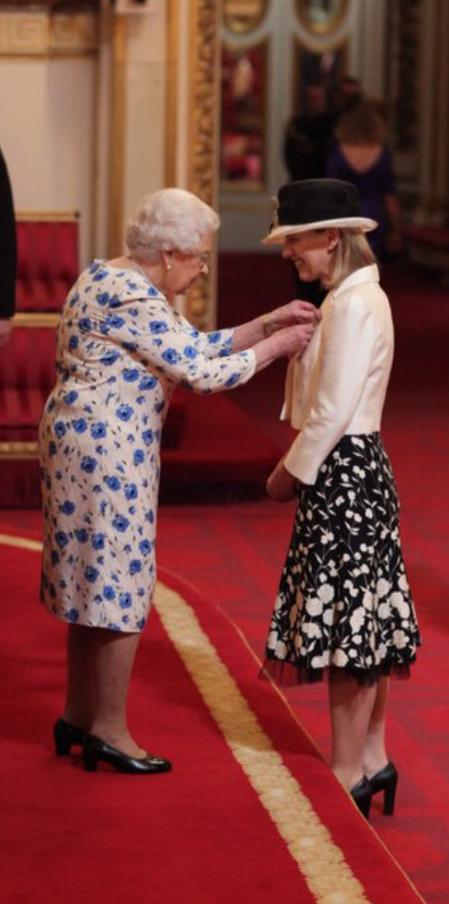
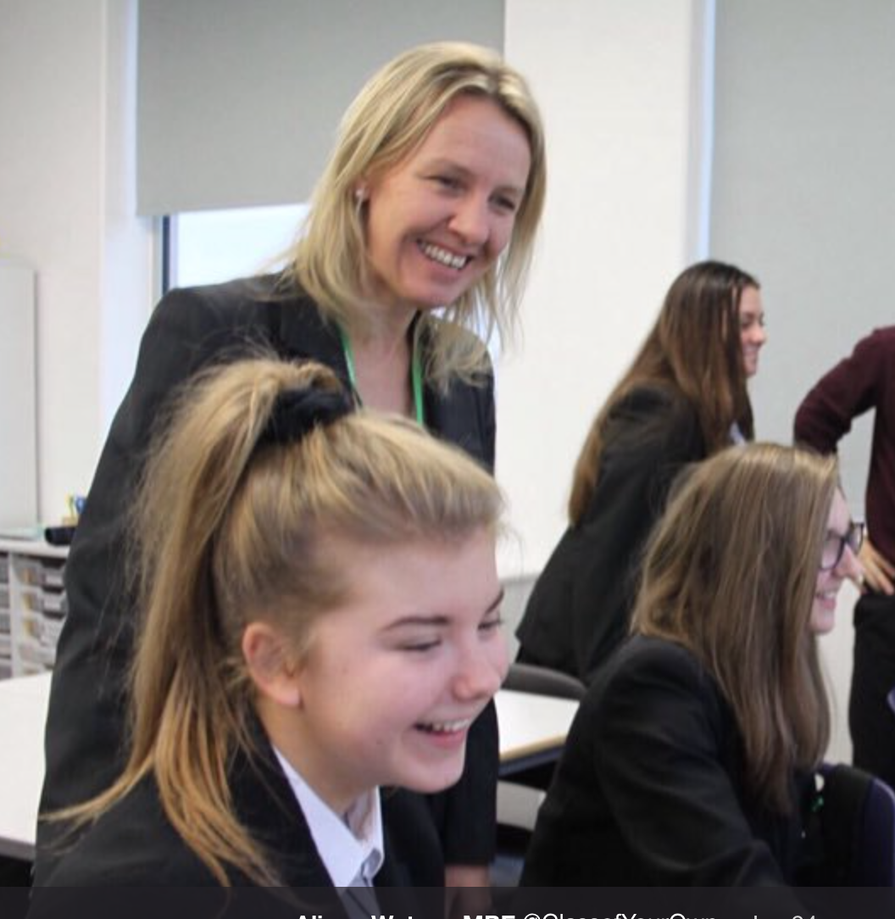

Collaboration 2019 - 2020
Alison Watson provides School Curriculum for 15-18 year olds (GCSE & A-Level) called Design Engineer, Construct
Alison currently writing Surveying GCSE
GKiS to help promote Alison into Schools worldwide
Alison to help GKiS write Curriculum for 8-12 Year olds.
GKiS Curriculum feeds directly into DEC Schools
www.classofyourown.com
Host Survey Fest October 2019 together

Slide 12

Comic Strip & Book
Comic Strips
Chapter 2: 6 episodes of comic strips, 1 released per month (June – November 2019)
In Print
  Ad in Geospatial Magazines:
    POB USA - 35,000 circulation
    Civil Engineering Surveyor UK - 5,000 circulation
  Ad in Nat Geo Kids - UK / Australia / New Zealand (distributed to over 120,000 kids)
Comic Book
Pre-Order in Spring 2020

Slide 13




SURVEY Fest Program
& Events
Pilot Program - spreading the world through education
When: October 1st 2019
Where: St Ambrose Barlow High School
For: Bringing industry and kids together
Organised by:
Supported by:

