Slide 1



Your Company?
Introduction to Surveying
An activity Pack for Scouts

Slide 2


LAND SURVEYING
or
GEOMATICS
Ask them if they have ever heard of these words??
Break it down ‘Geo’ and ‘Matics’???
Explain the difference

Slide 3


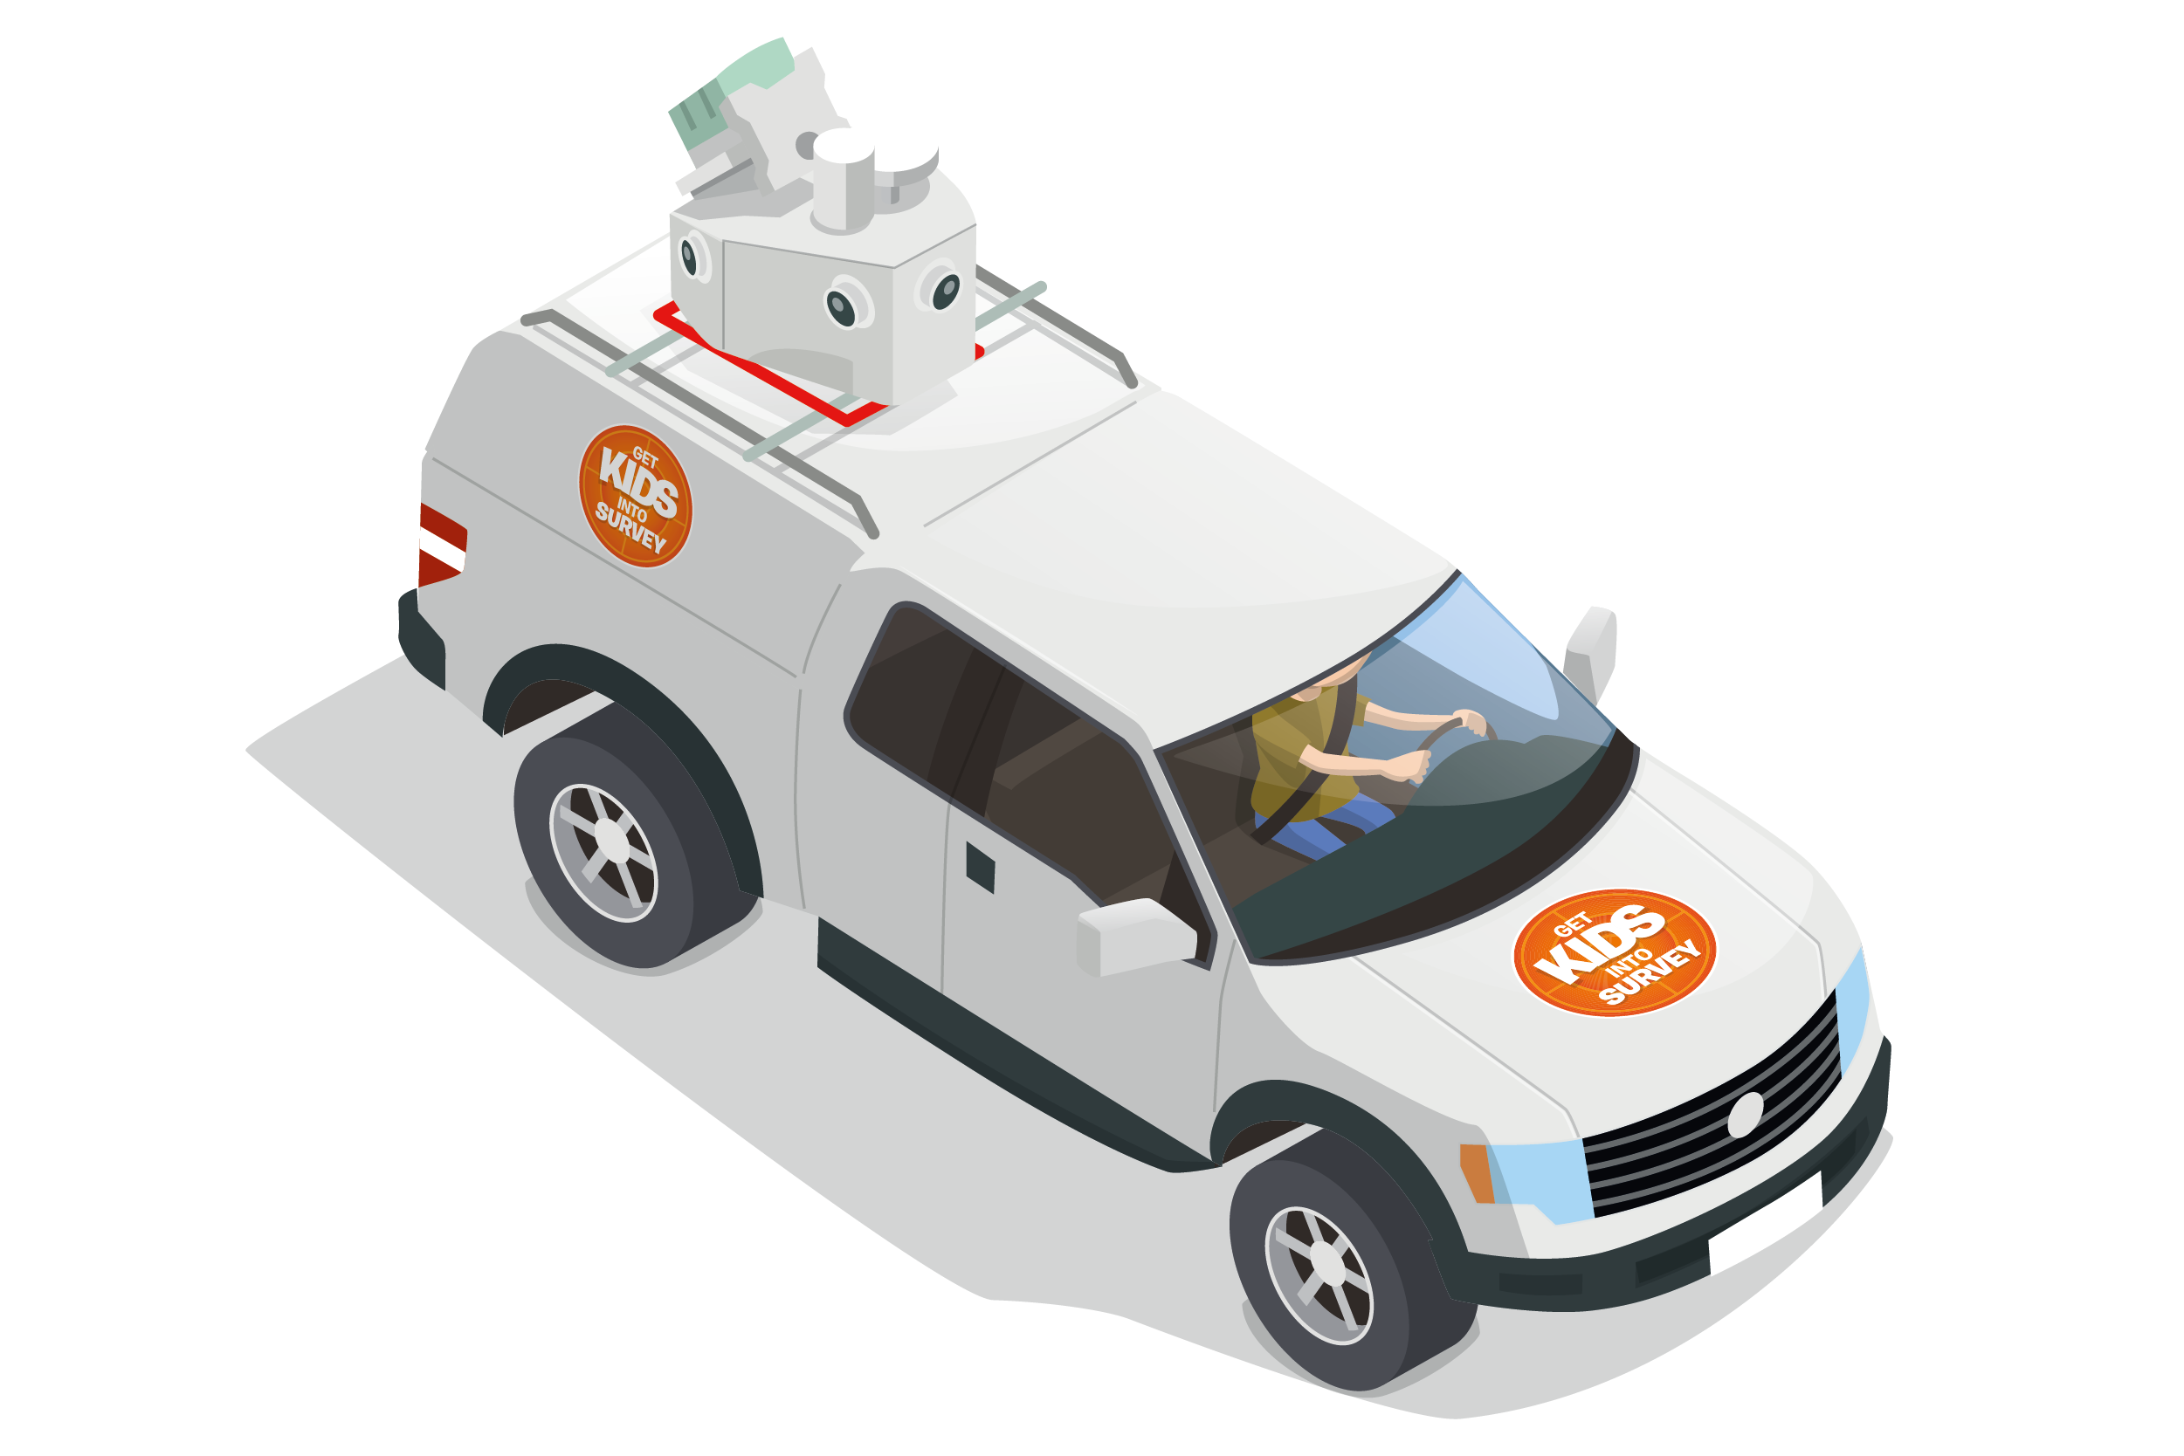
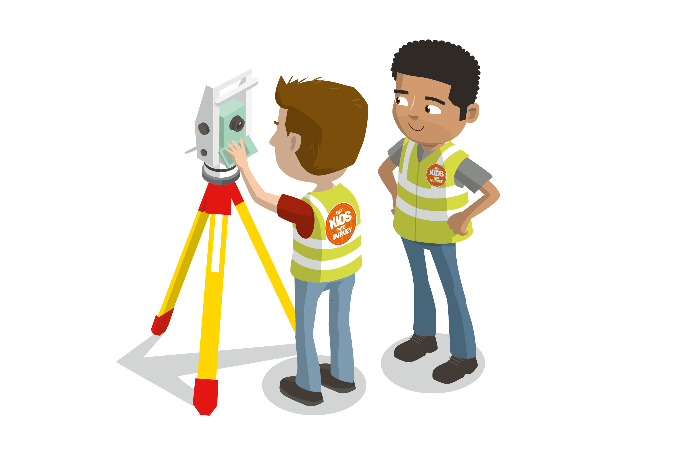


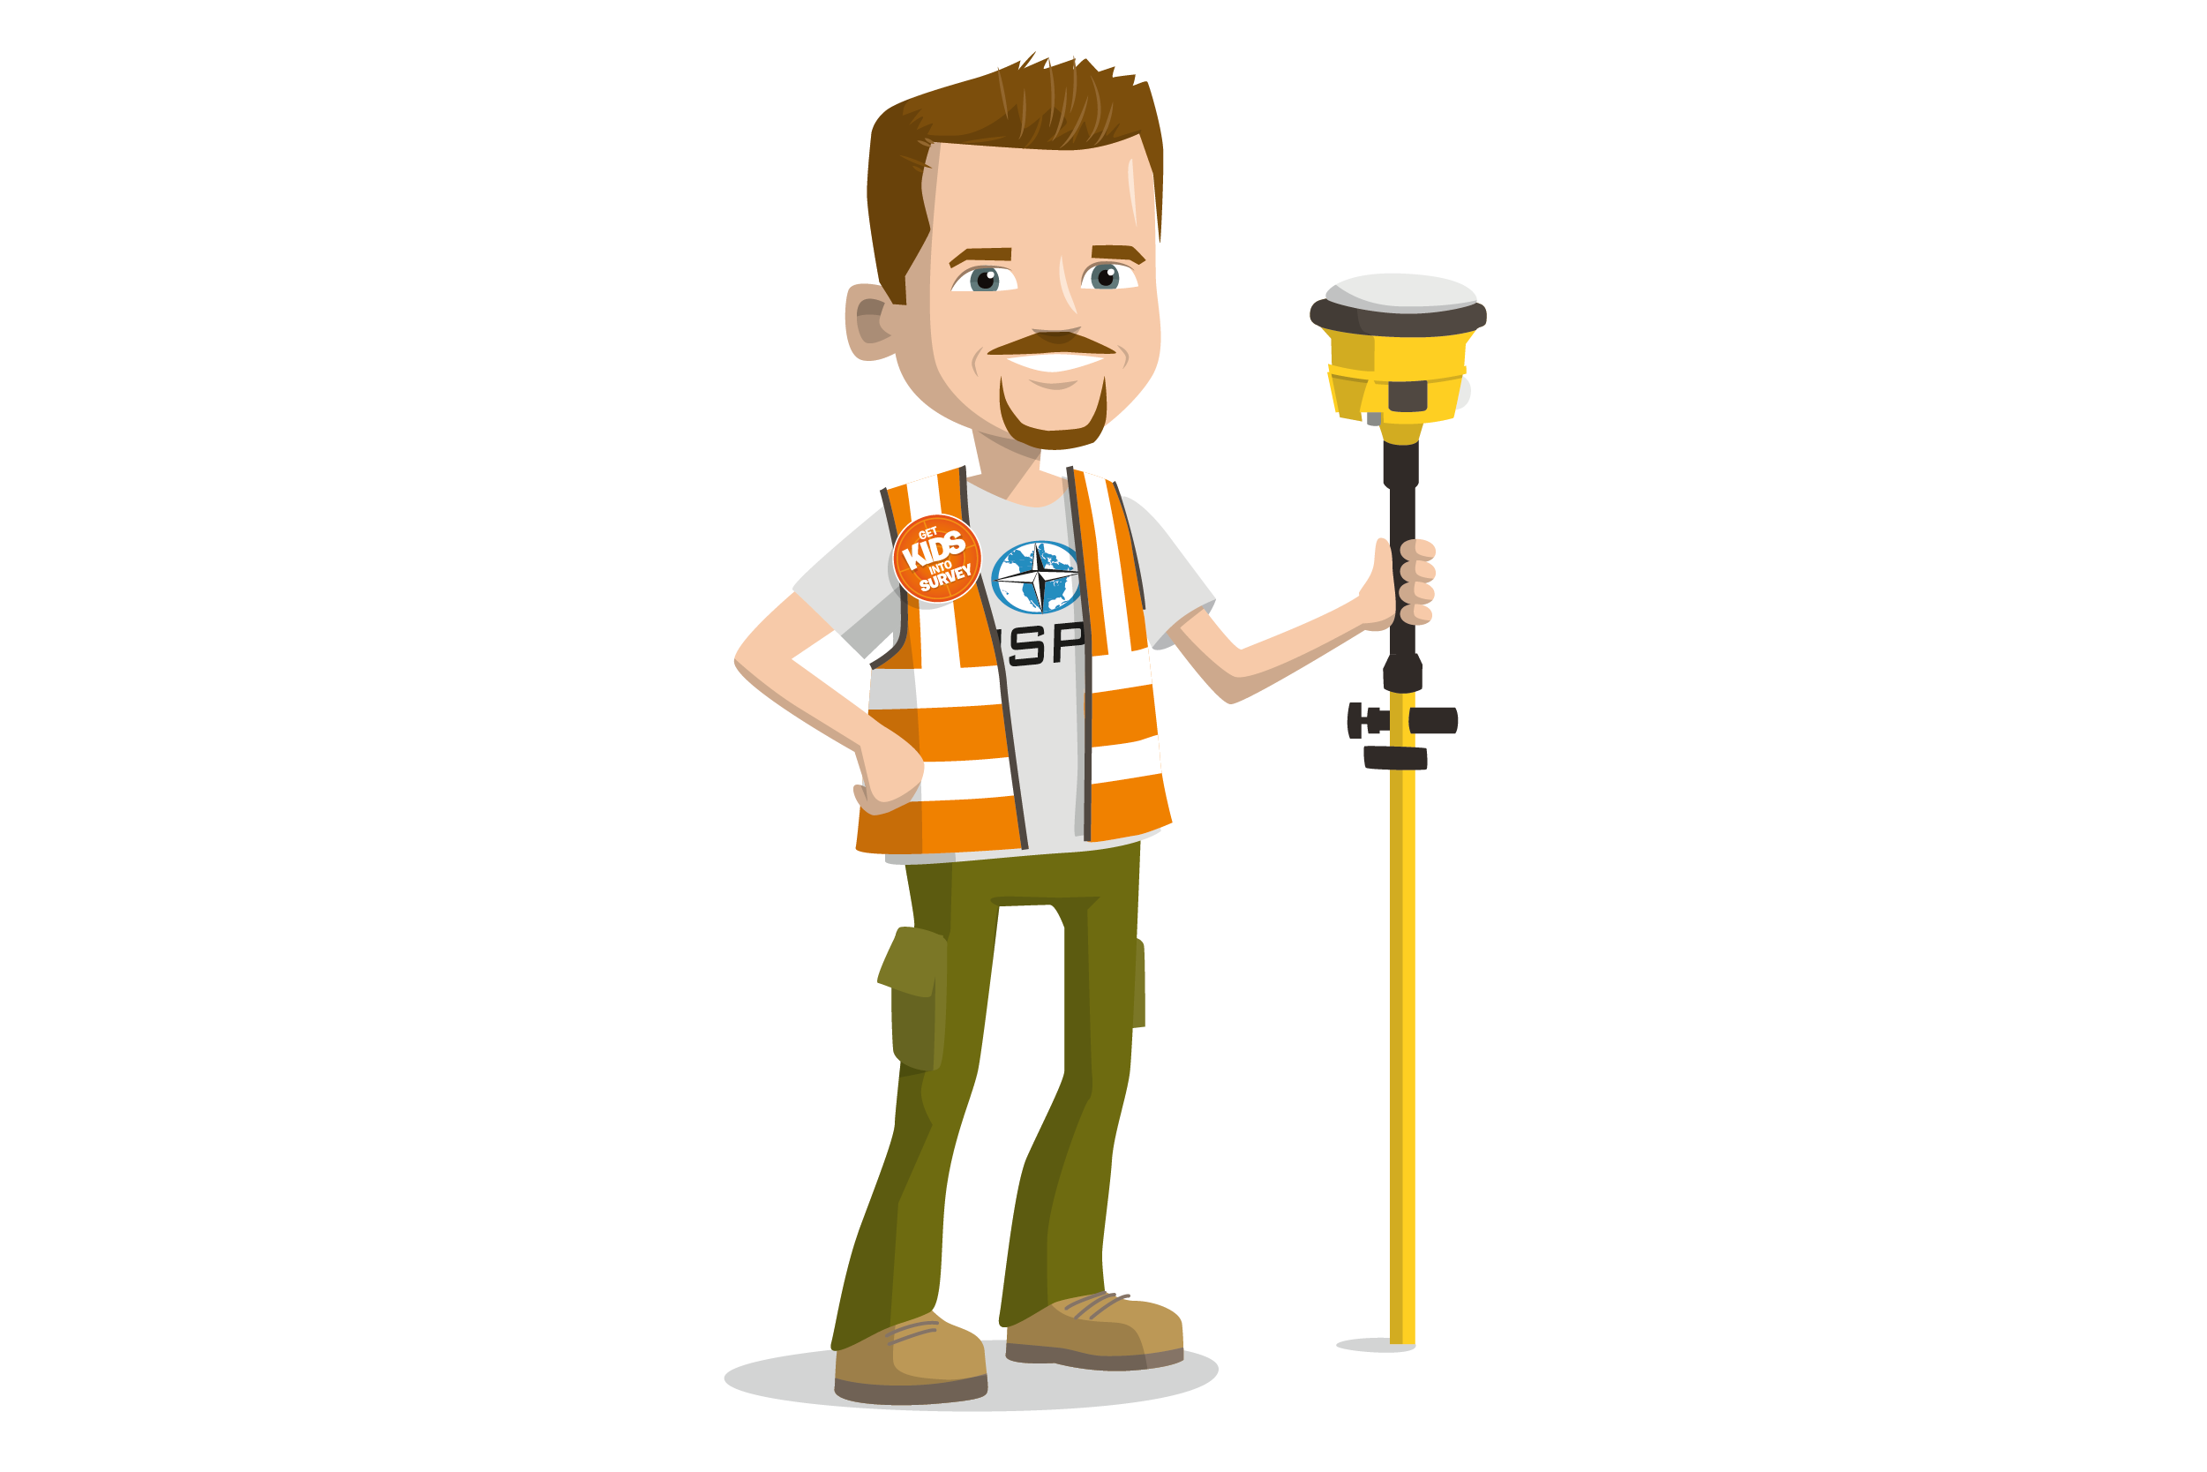
So…. what is land surveying and what do land surveyors do?
Ask the kids to shout out some ideas.
Using these photos as prompts will help them come up with some.

Slide 4
So…. what is land surveying and what do land surveyors do?
Make maps
Measure things
Make sure things are built in the correct place
Monitor movement, building or flood defence
Machine control
Calculate quantities of materials
Cut and Fill analysis
Athletics
World records
Chartered Institute of Civil Engineering Surveyors
Here you can make it more specific, include examples of some of the jobs you do day to day
Relate it to activities they will have heard of??
Pictures of some of the projects you have worked on??
At this point is a really good time to play this video, it is a great tool to sum up what surveyors do in a very easy to follow style.

Slide 5
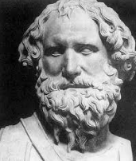




History
Where did it all start?
Talk a bit about how it started do they know any of these faces??
Old methods of surveying they might have heard of
Interpret this to your specific form of surveying

Slide 6
What is GPS?
GNSS/GPS
Global Navigation Satellite Systems
GPS/Navstar – American
GLONASS – Russian
Galileo – European
BeiDou – Chinese
Quasi Zenith – Japan
NAVIC - India
How do you use GPS?
Bring it quickly from old surveying practises into the 21st century so they can relate to it. Talk about misuse of the word GPS - in fact these are all types of satellites.
They might know about some rocket launches??
Ask them how they might use GPS in their day to day life?

Slide 7
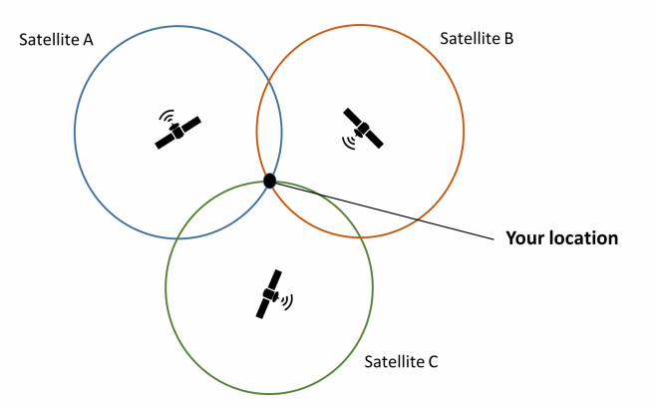
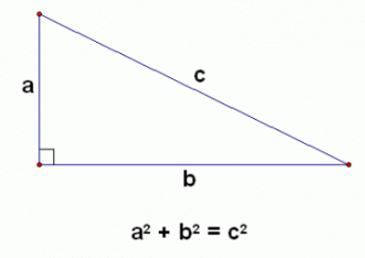
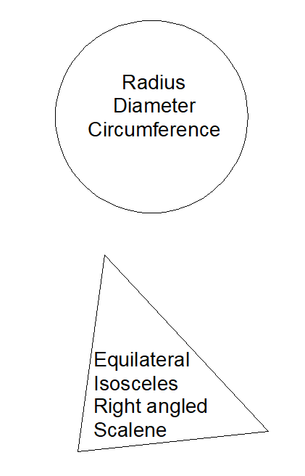
STEAM
Science, Technology, Engineering, Arts, Maths
Pythagoras theorem
Geometry
Trilateration
Do they already learn about trig in school??
Talk about the applications of this in a career in surveying?
Do they know how satellites work – in relation to the previous slide?

Slide 8
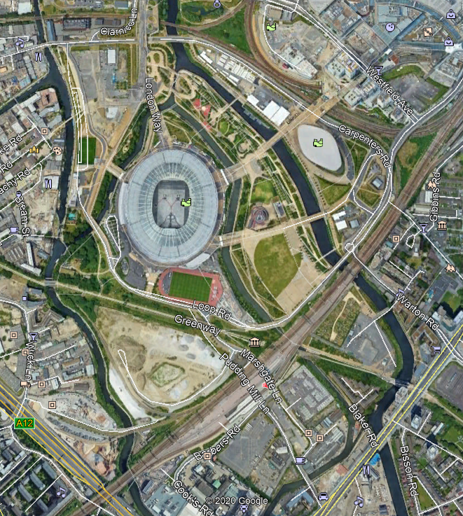
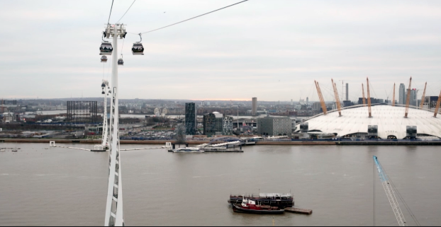
Jobs in Surveying
Talk about other jobs in surveying some more examples perhaps and case studies that you have??

