Slide 1




Every young person should know about surveying as a career.
- A Scout initiative.

Slide 2




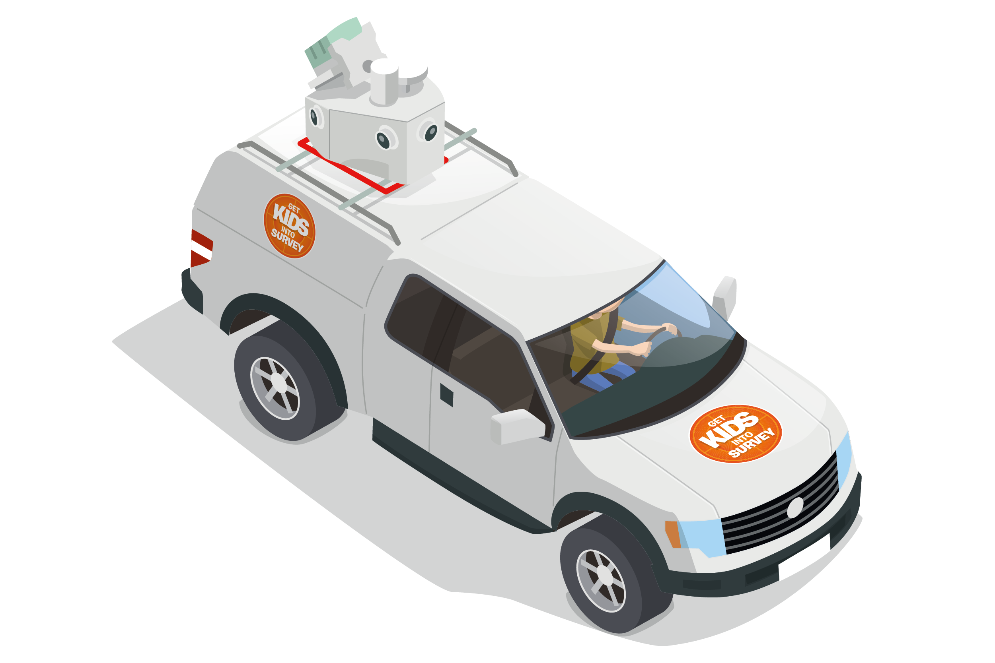
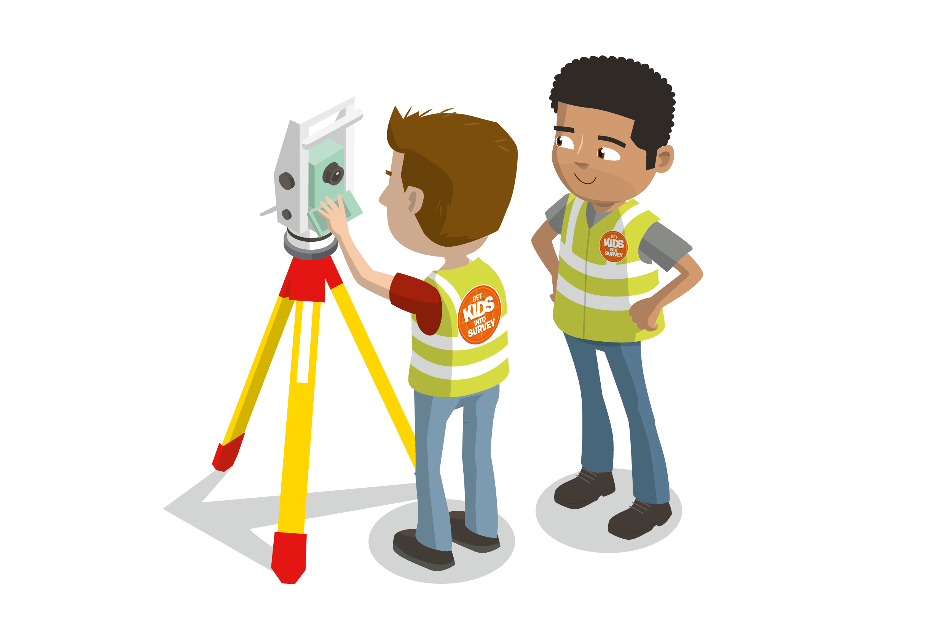
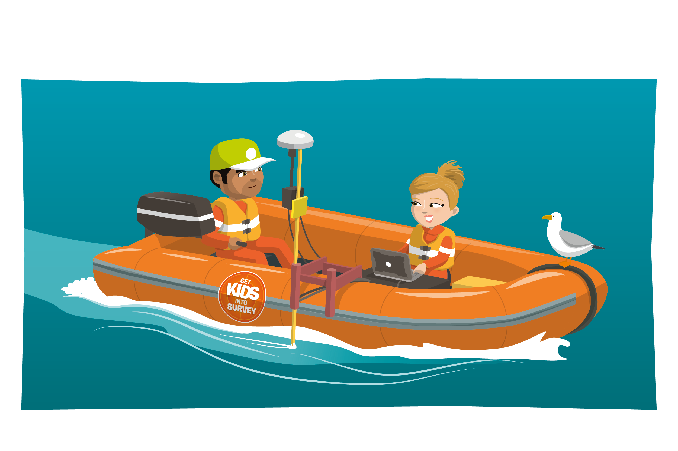

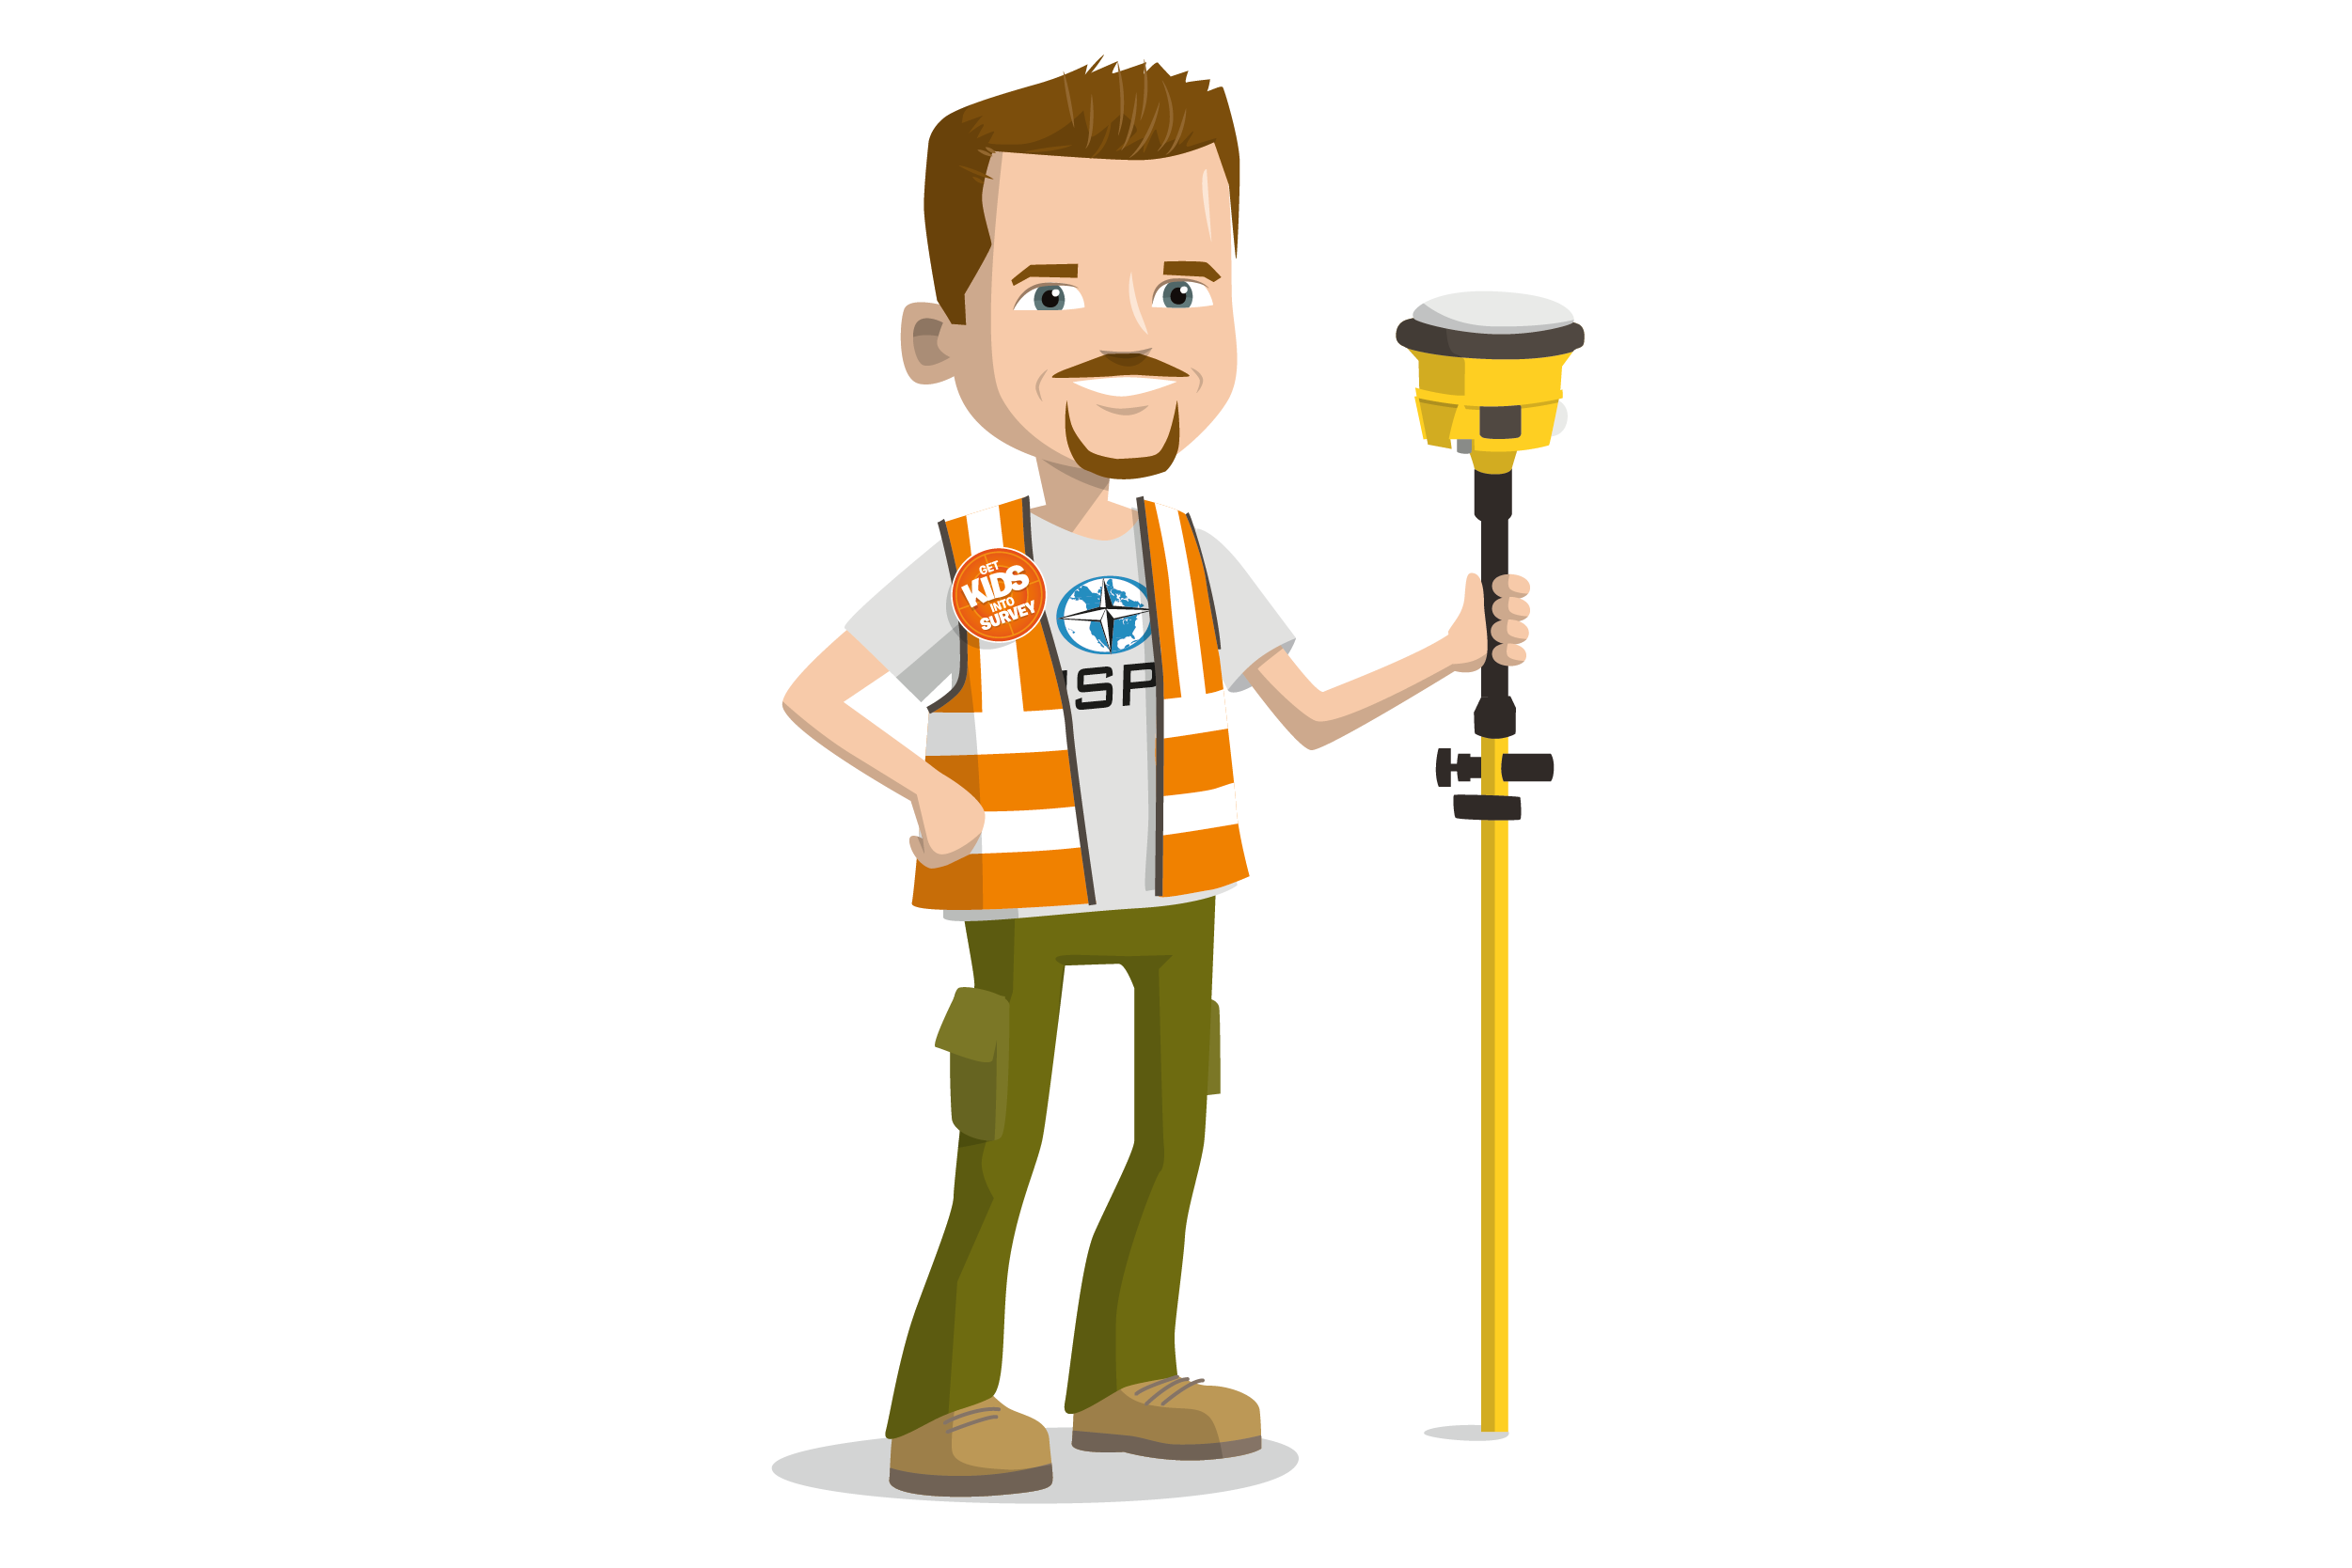
So…. what is land surveying and what do land surveyors do?

Slide 3
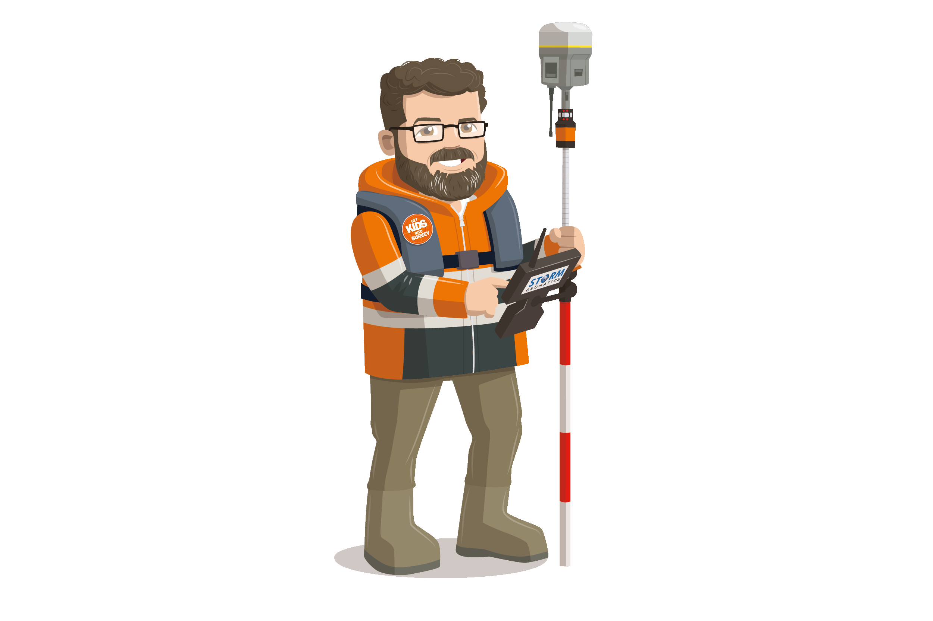
LAND SURVEYING
Measure and map features and boundaries on earths land, sky and sea.

Slide 4
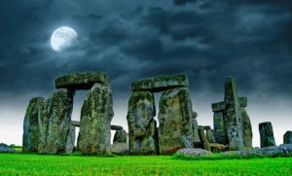


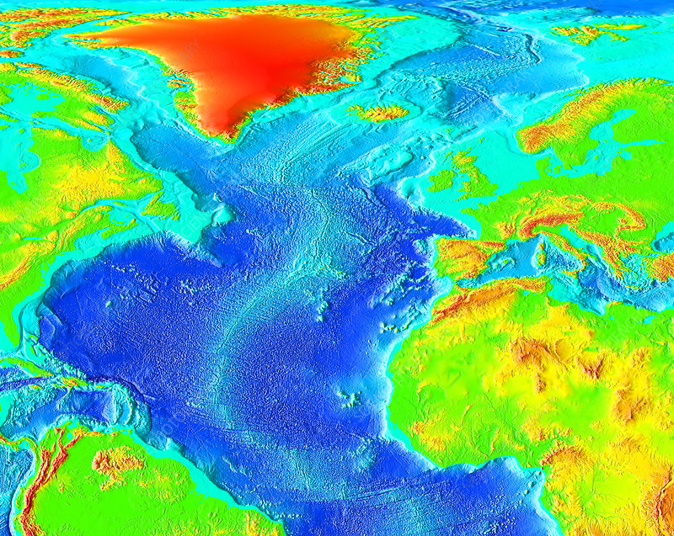
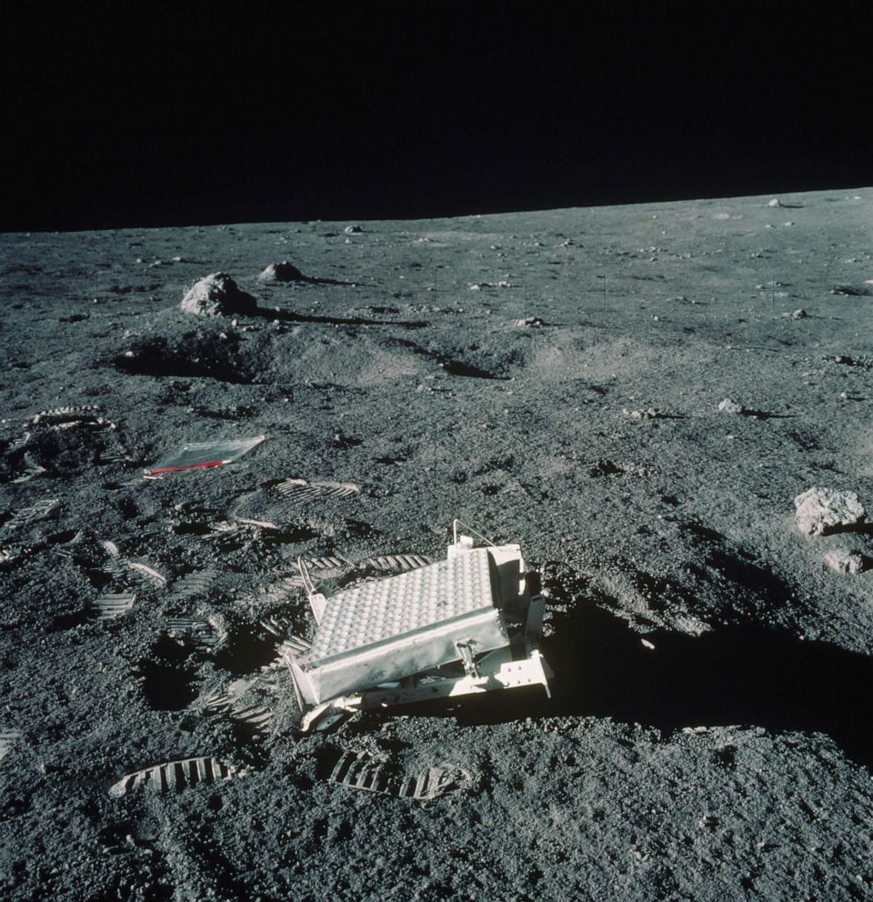

What are some examples of geospatial Projects they will have heard of?

Slide 5

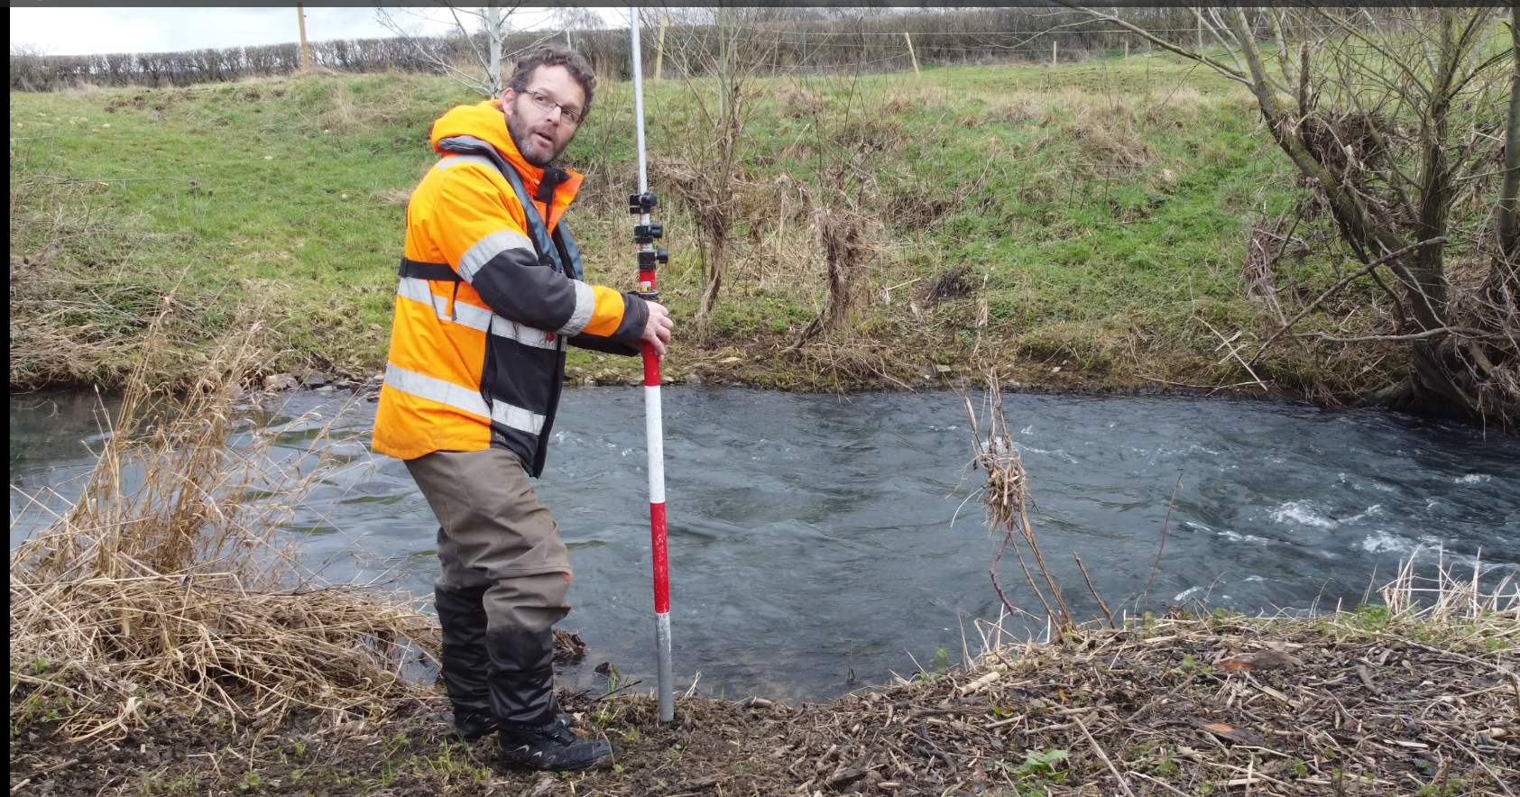
Types of surveyor

Slide 6
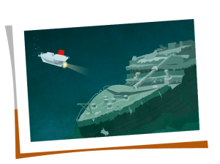
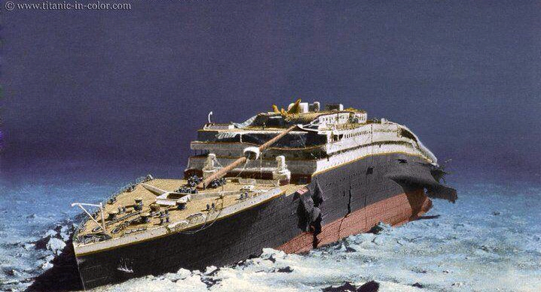
Hydrographic Surveyor
- The science of measurement and description of features which affect maritime navigation, marine construction, dredging, offshore oil exploration and drilling and related activities.
Robert Ballard Naval officer and surveyor– 1985
Secret reconnaissance of the wreckage of two Navy nuclear powered attack submarine but instead found……
Planning underwater cables
Nautical navigation
Offshore wind farms, oil, gas etc.

Slide 7
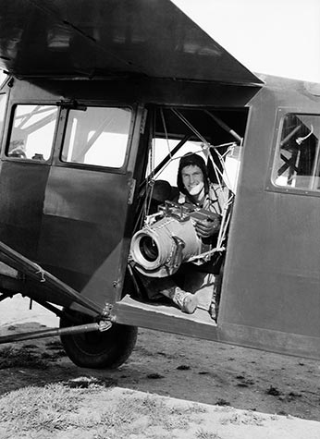
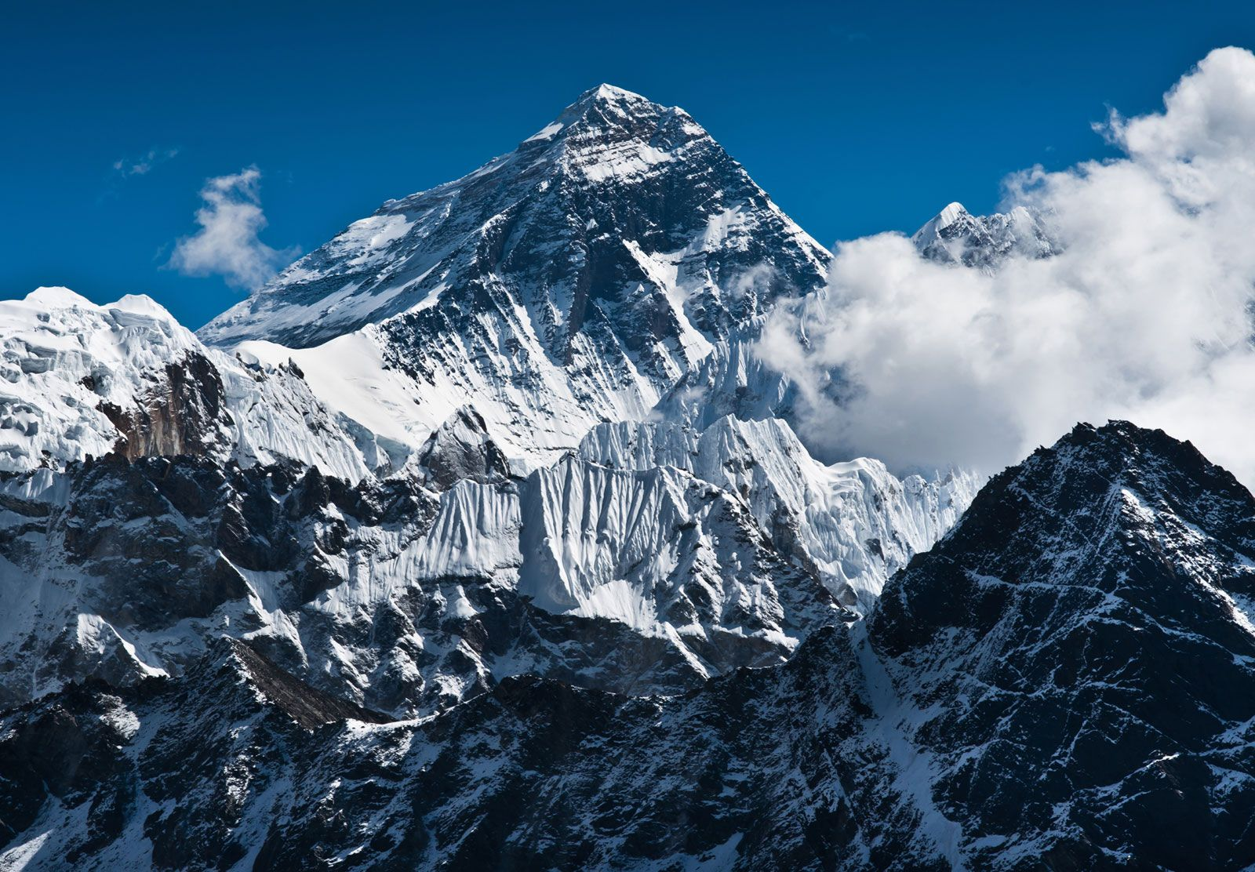
Topographic Surveyor
- To gather spatial information relating to the site and its natural and man-made land features.
Bradford Washburn – 1999, Topographic Cartographer
- GPS equipment was carried to the summit of Mt Everest and found it was in fact 7 feet taller than previously recorded.

Slide 8
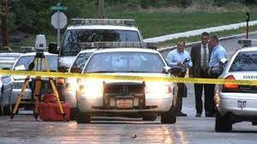

Other types of surveying
Building/ construction
Mine surveyors
Land surveyor
Quantity surveyor
Forensic surveyor
Topographic surveyor
Aerial surveyor – Drones/Planes

Slide 9

What is GPS?
GNSS/GPS
A satellite navigation or satnav system is a system that uses satellites to provide autonomous geopositioning.
Global Navigation Satellite Systems
GPS/Navstar – American
GLONASS – Russian
Galileo – European
BeiDou – Chinese
Quasi Zenith – Japan
NAVIC - India
How do you use GPS?

Slide 10
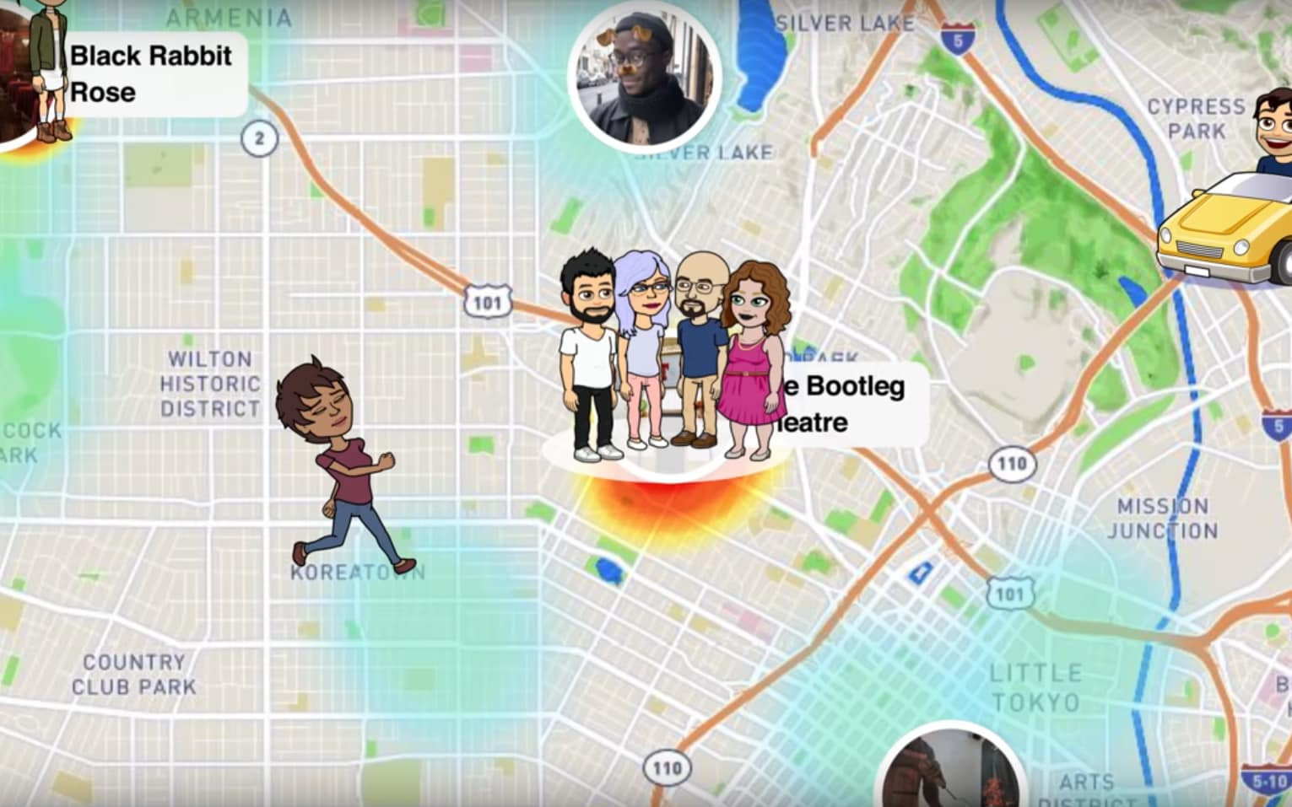




Slide 11
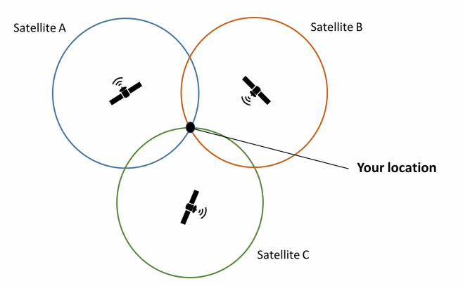
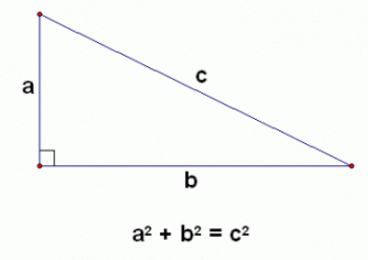
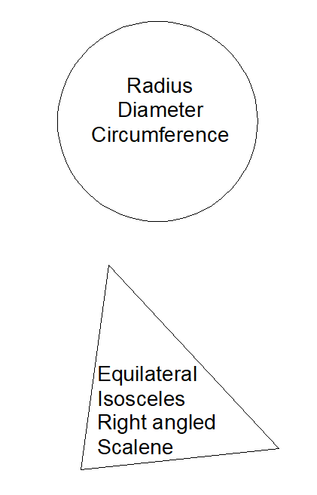
STEAM
Science, Technology, Engineering, Arts, Maths
Pythagoras theorem
Geometry
Trilateration

Slide 12
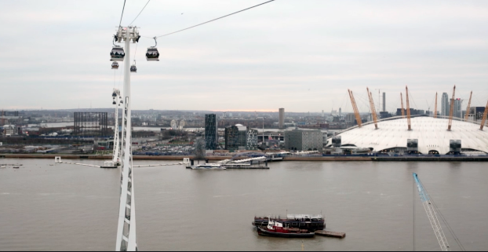
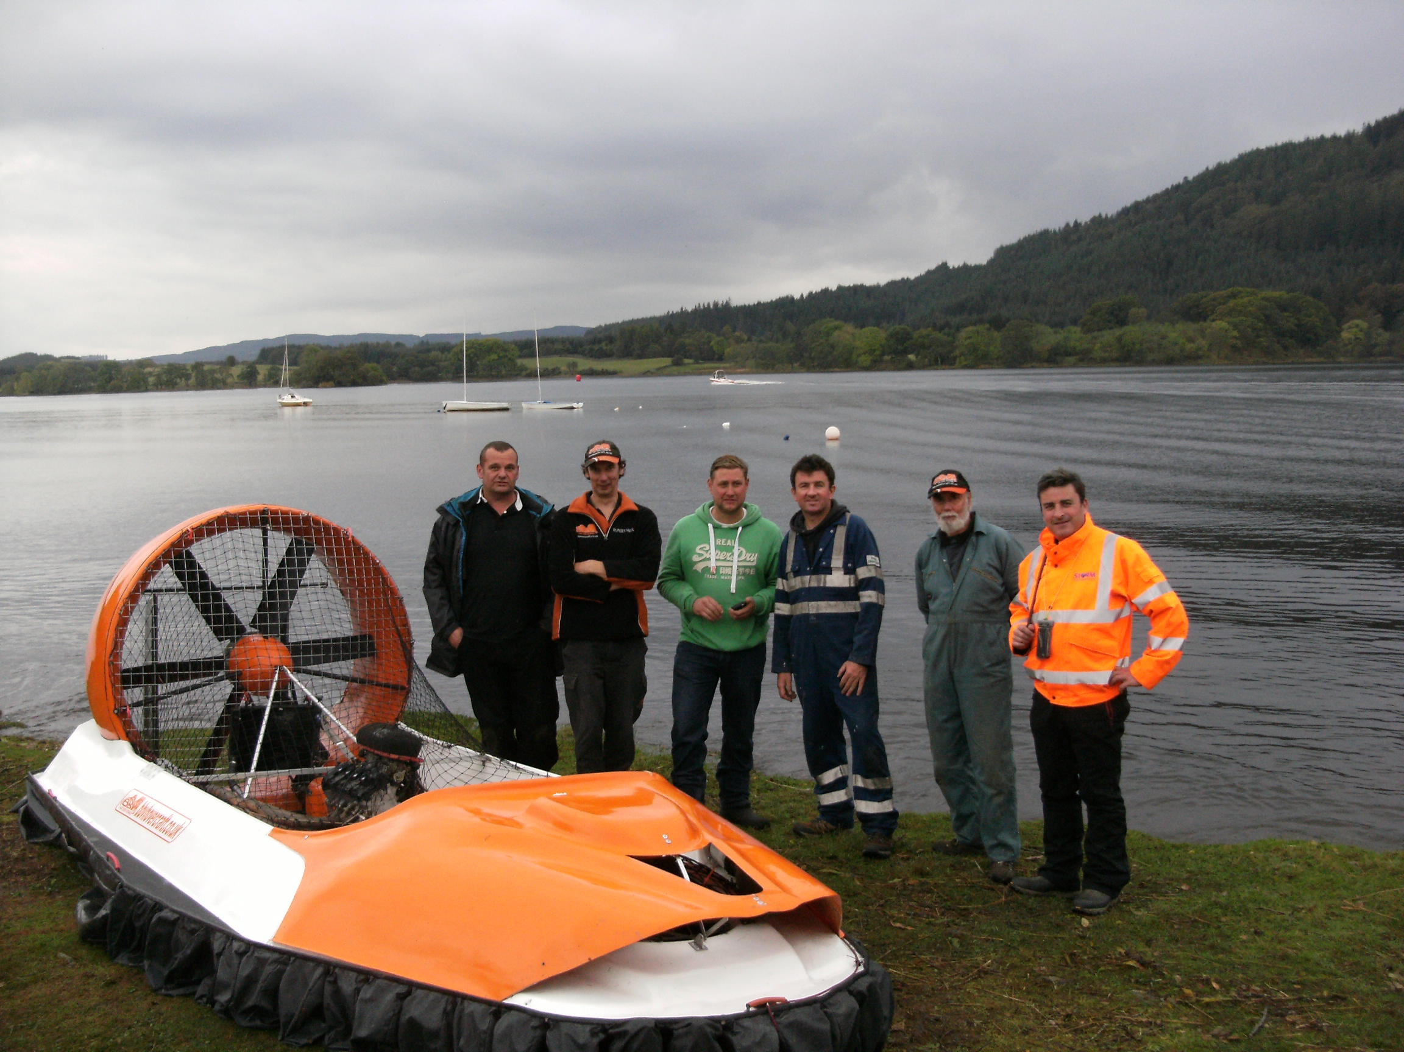
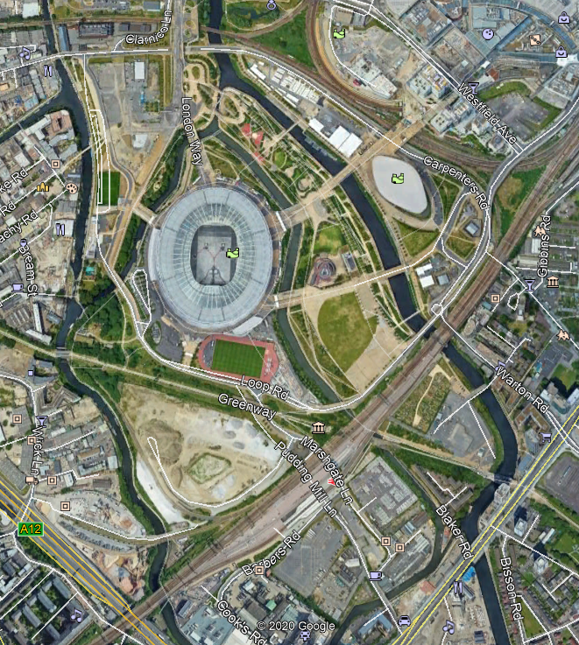
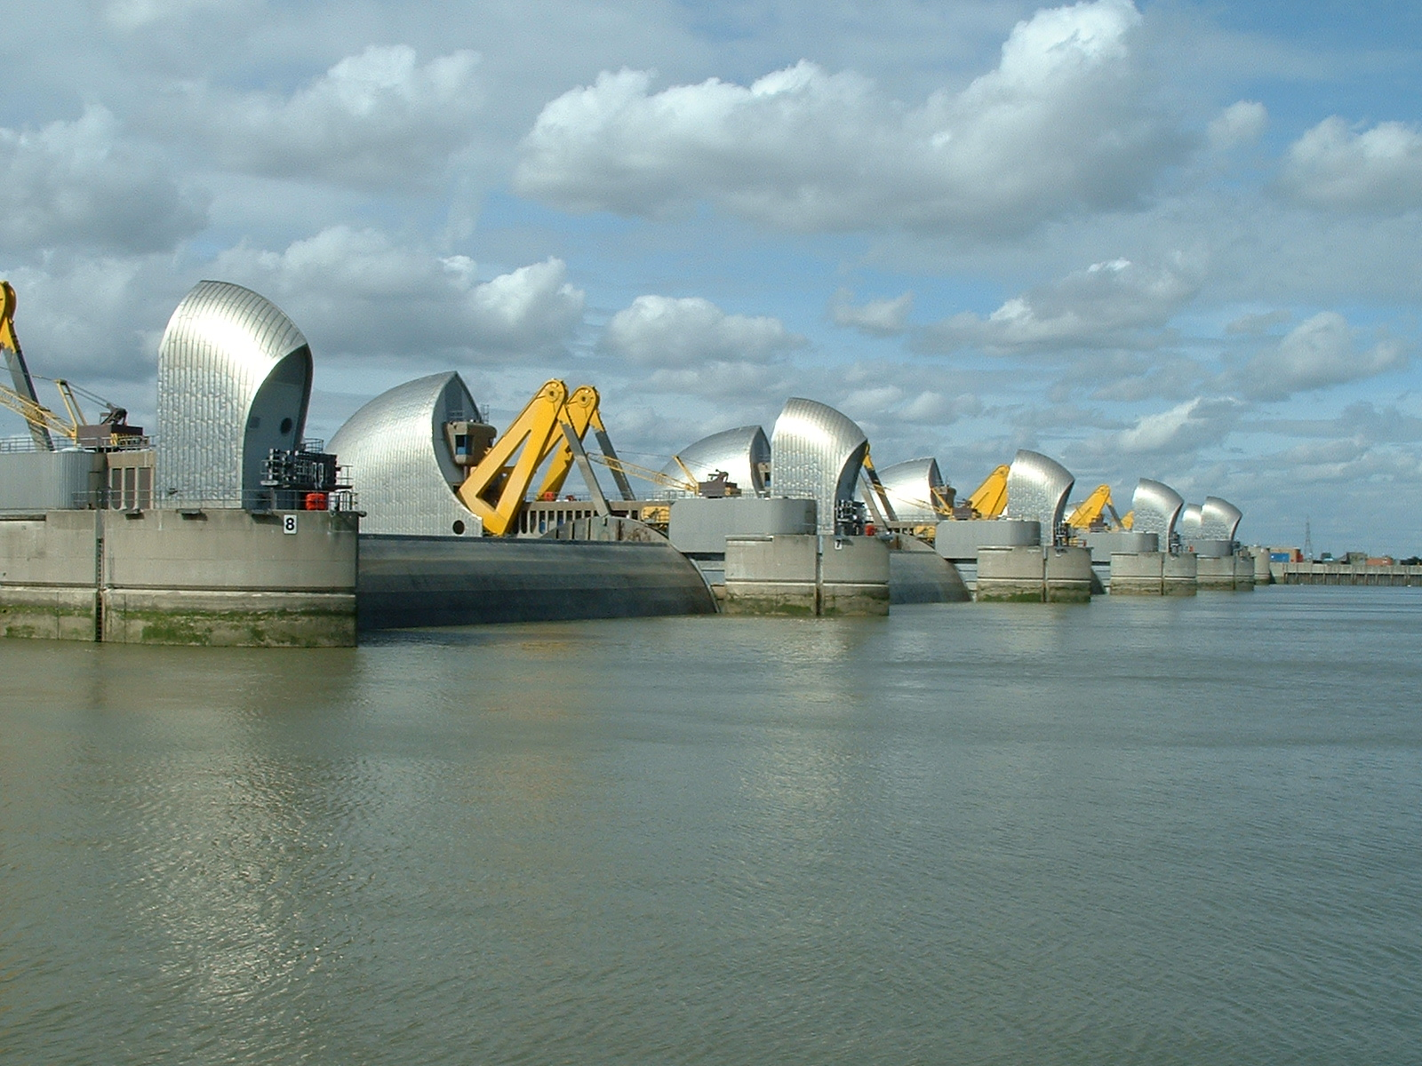
Storm in Surveying
(Insert your own projects here )

Slide 13
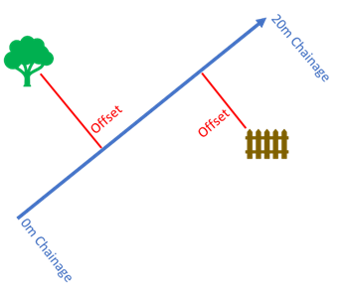
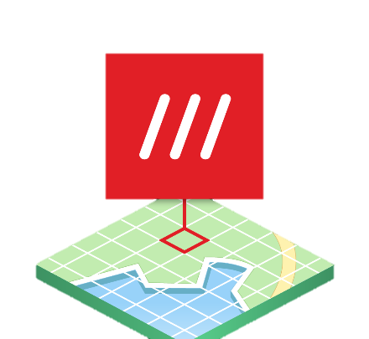
Chainage and Offset Survey
What3Words

